Slide 1
Developer Circles Innovation Challenge Viet Nam In Partnership with Coder Schools
CHECK ID CARD REAL/FAKE
PROBLEM OF FE CREDIT
Team: FIND FAKE

Slide 2
Members
Đặng Hoàng Oanh – Product Management
Hoàng Xuân Trường – Data Science
Trần Quang Hưng – Data Science
Phạm Minh Chiến – Data Science
Nguyễn Văn Lân – React Native

Slide 3
IDEA
Use Document template check verification to detect national emblem
Standardized brightness
Optical Character Recognition (OCR) to crop ID numbers and collate with provincial list then return result
Check date of birth is valid ( example : not enough 14
year old ; 30/2/2019 is not valid )
Check the district belong to the province
Face Recognition
Compare Selfie photo with image in ID card ( without glasses , mask )

Slide 4
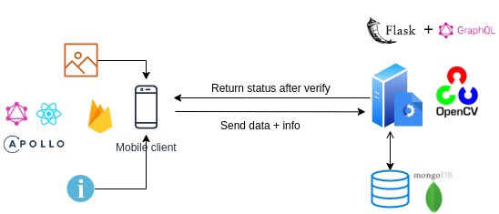
Technical Craftmanship
FRONT-END :
REACT NATIVE
APOLLO CLIENT
GRAPHQL
BACK END:
FLASK
GRAPHQL
GRAPHENE
MONGOENGINE
OPENCV
TESSRACT
FACE RECOGNITION

Slide 5
UI/UX
Pain Point : FEC is currently offering many products and services over the digital channels and thus face many online frauds from customers such as using fake IDs to apply or using unauthorized information from others to apply for loans online.
Solution : Building a fake identity detection app to minimize risks
Idea of my team is build an online college application which uses the identity card check feature

Slide 6
Product future
Develop a face recognition application instead of ID card
Through airlines , custom, university exam …
Long- term plan : seeking investment to develop additional features for app
Develop more feature : check embryos of people's identity standards

Slide 7
THANKS FOR WATCHING
Presentation by : FIND FAKE

